Slide 1
Engineering Management Principles and Economics ENGR 301
Lecture 5A
Economic Decisions
Cash Flow Diagrams
Interest and Equivalence
Dr C.J. Willis, CAPM, P.Eng
‹#›

Slide 2
Learning Objectives
Learners will:
Be introduced to various economic definitions and variables
Be introduced to the scope of economic decisions
Understand the types of engineering costs
Understand what are cash flow diagrams
Be introduced to the concepts of interest and equivalence
References:
Engineering Economic Analysis: Second Canadian Edition, Newnan, D., Eschenbach, T., Whittaker, J. & Lavelle, J. Chapters 1, 2, 3
Dr C.J. Willis, CAPM, P.Eng
‹#›

Slide 3
Definitions
Principal: initial amount of money involved in debt or investment
Interest rate: the cost or price of money and is expressed in percentage per period of time
Interest period: is the period of time that determines how interest is calculated (monthly, quarterly, yearly)
Number of interest periods: specifies the duration of transaction
A plan for receipts or payments: cash flow pattern over a specified length of time
Future amount of money: the end value after the cumulative effects of interest rate over a number of interest periods
Dr C.J. Willis, CAPM, P.Eng
‹#›

Slide 4
Definition of Variables
i= interest rate per interest period
n= number of interest periods
P= a present sum of money. The sum of money at time zero of the analysis. Also called the present value or present worth
F= a future sum of money. The future sum F is an amount, n interest periods from the present, that is equivalent to P with interest i. The sum of money at the end of the analysis period. Also called the Future Value or Future Worth
Dr C.J. Willis, CAPM, P.Eng
‹#›

Slide 5
Definition of Variables
A = an end-of-period cash receipt or disbursement in a uniform series continuing for n periods, the entire series equivalent to P or F at interest rate i. The value of payment or receipt at the end of some interest period.
Dr C.J. Willis, CAPM, P.Eng
‹#›
Notes:
Chapter 1 of the course text outlines and describes the decision making process.
One possible Decision making process: Recognize the problem; define the goal or objective; assemble relevant data; identify feasible alternatives; Select the criterion to determine the best alternative; construct a model; Predict the outcomes or consequences for each alternative; choose the best alternative; audit the results
‹#›

Slide 6
Economic Decisions
The world is full of problems which require us to make decisions.
Problems can be categorized as being
Simple
Intermediate
Complex
Intermediate problems are primarily economic
Shall I buy or lease my next car? Which materials should be used as roofing, siding and structural support for a new building?
Dr C.J. Willis, CAPM, P.Eng
‹#›

Slide 7
Economic Decisions
Economic decision making is used to determine:
Investment alternatives
Equipment replacement
Equipment selection and improvements
Process improvement
Dr C.J. Willis, CAPM, P.Eng
‹#›

Slide 8
Engineering Costs
Evaluating a set of feasible alternatives requires that many costs be analyzed:
Fixed Costs:
Constant unchanging costs
Variable Costs:
Depend on the level of output or activity
Marginal Costs:
Variable cost for one more unit
Average Costs:
Total cost divided by the number of units
Dr C.J. Willis, CAPM, P.Eng
‹#›

Slide 9
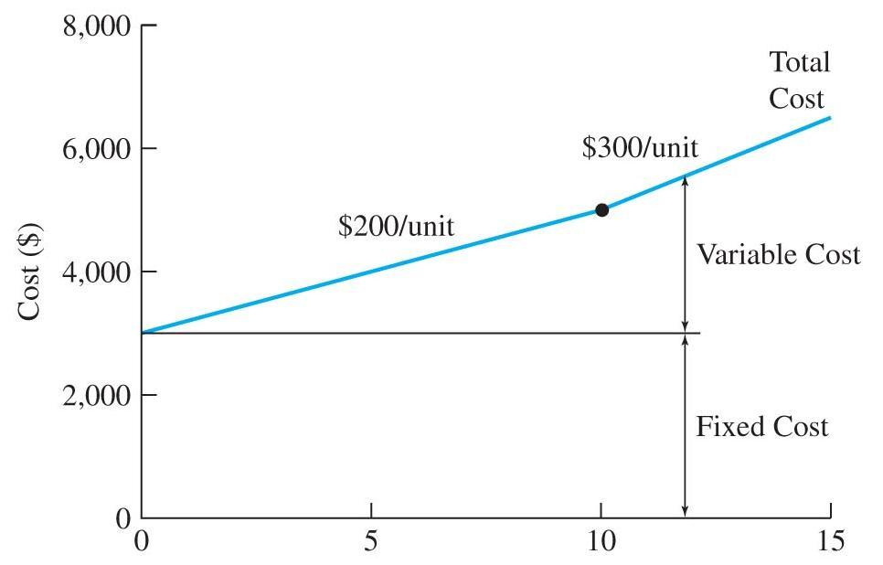
Total Costs
Total Cost = total fixed cost + total variable cost
Dr C.J. Willis, CAPM, P.Eng
‹#›
Notes:
This is a test
‹#›

Slide 10
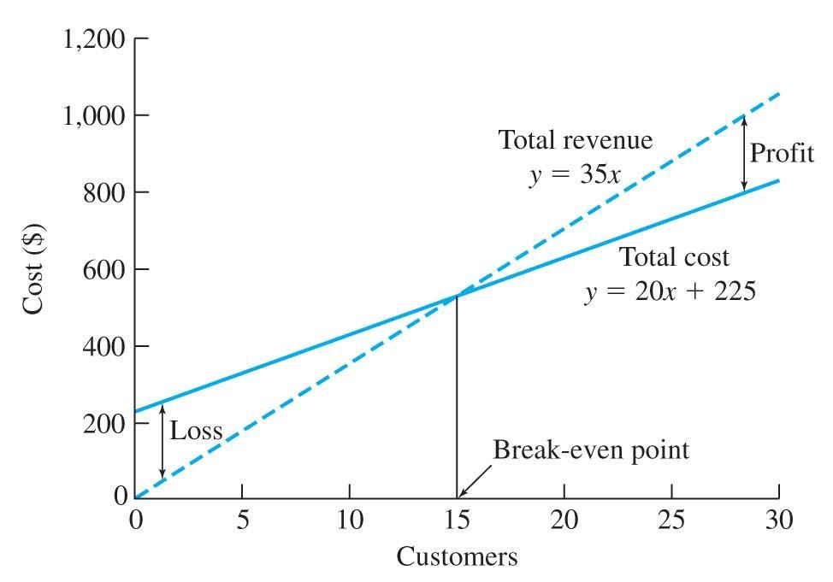
Profit/Loss Breakeven Chart
Break-even point: total costs = total revenue
Profit region: total revenue > total costs
Loss region: total costs > total revenue
Dr C.J. Willis, CAPM, P.Eng
‹#›
Notes:
Fixed costs: fixed or unchanging regardless of the level of output or activity. E.g. Cost for factory floor space and equipment does not change based on production quantity or number of employees
Variable costs: E.g. labour costs, depends on the number of employees and the hours worked
Marginal Costs: costs incurred for producing an additional unit.
Marginal cost usually decreases as the number of units produced increases. This is because overhead and profit is spread over many more units. This is not the case if overtime work is involved
‹#›

Slide 11
Other Types of Costs
Sunk Costs
Money already spent
Past decision
Should be disregarded in engineering economic analysis
Nothing can be done at this point to change the cost
Dr C.J. Willis, CAPM, P.Eng
‹#›

Slide 12
Other Types of Costs, cont’d.
Opportunity Costs
The costs associated with a resource being used for an alternate task
Sometimes referred to as ‘forgone opportunity costs’
‘An opportunity cost is the benefit that is forgone by engaging a business resource in a chosen activity instead of engaging that same resource in a forgone activity.’
Dr C.J. Willis, CAPM, P.Eng
‹#›
Notes:
This is a graph of fixed, variable and total cost
X axis is number of units
Variable costs are usually linear.
In this example the variable cost is $200 / unit up to 10 units then increases to $300 per unit onwards.
In the example the marginal cost at a volume of 5 units is $200 per unit while at a volume of 12 units it is $300 per unit. One possible reason for this is because there is overtime involved
‹#›

Slide 13
Other Types of Costs
Recurring Costs
A cost that reoccurs at regular intervals
Non-recurring Costs
One-of-a-kind costs recurring at irregular intervals
Incremental Costs
Cost differences between alternatives
Cash Costs versus Book Costs
Cash costs require a cash transaction (cash flow)
Book costs are recorded but are not transactions
Dr C.J. Willis, CAPM, P.Eng
‹#›
Notes:
Break even point: total costs to provide the product or good or service is equal to the revenue generated by the good or service
Profit Region: output level of the variable x greater than the break even point. total revenue greater than total costs
Loss region: output level of the variable x less than the break-even point
‹#›

Slide 14
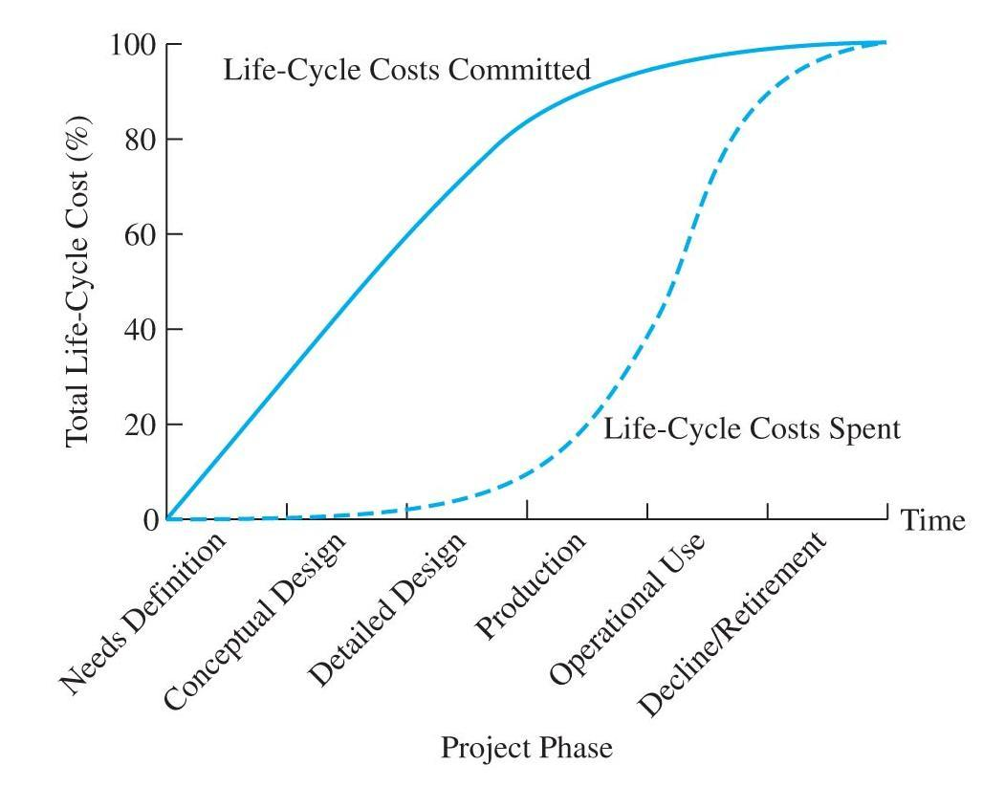
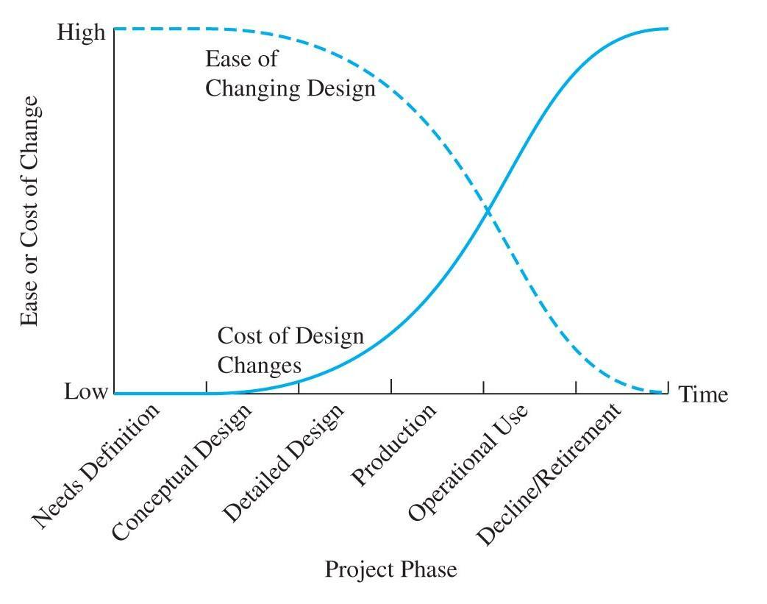
Life-Cycle Costs
Goods and services are designed and progress through a life-cycle.
Life-cycle costing:
Considers the costs over the entire life-cycle
Dr C.J. Willis, CAPM, P.Eng
‹#›
Notes:
Sunk cost is money already spent as a result of a past decision. Sunk costs should be disregarded from our economic analysis because current decisions cannot change the past.
Example of a sunk cost: money spent last year to purchase new machinery is money that is sunk. The money has already been spent and there is nothing that can be done now to change that action.
‹#›

Slide 15
Cash Flow Diagrams (CFD)
The costs and benefits of engineering projects occur over time and are summarized on a cash flow diagram (CFD)
A CFD illustrates the size, sign and timing of individual cash flows.
In this way, the CFD is the basis for engineering economic analysis
A CFD is created by firstly drawing a segmented horizontal line, divided into time units.
At each time at which a cash flow will occur, a vertical arrow is added.
Dr C.J. Willis, CAPM, P.Eng
‹#›
Notes:
Example of opportunity cost: purchasing a new car. The opportunity cost is putting the money in a high interest account. The interest the money would receive is the opportunity cost.
Use of an assembly line to produce a different product.
‹#›

Slide 16
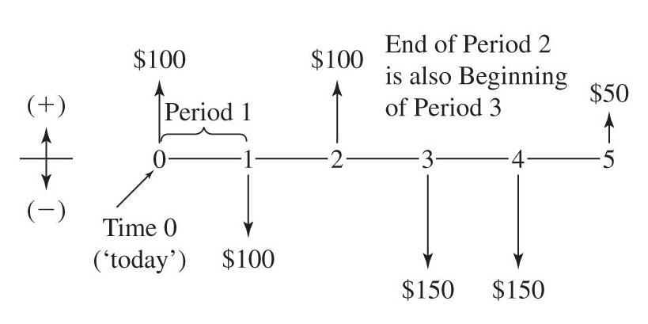
Cash Flow Diagrams
Costs and Benefits over time can be represented by a cash flow diagram:
Cash flows are assumed to occur at the end of each period.
Dr C.J. Willis, CAPM, P.Eng
‹#›
Notes:
Recurring cost is an expense that is known and anticipated. Example of recurring cost would be annual expenses for maintenance and operation.
Non recurring costs: emergency maintenance, cost of installing a new machine
Incremental costs: in choosing between alternatives the focus is on the difference between alternatives. Example: in choosing 2 options for leasing a vehicle the comparison should focus on the costs that are not the same
Example of cash cost is when you buy dinner and pay with money out of your pocket
Book costs are cost effects from past decisions that are recorded in books (accounting books)
Asset depreciation is an example of book costs. Book costs are not usually included in engineering economic analysis.
‹#›

Slide 17
Categories of Cash Flows
Expenses and receipts of engineering projects usually fall into one of the following categories:
First Cost: expense to build or to buy and install
Operations & Maintenance: annual expense, such as electricity, labour and minor repairs
Salvage Value: receipt at project termination for sale or transfer of equipment
Revenues: annual receipts due to sale of products or services.
Overhaul: major capital expenditure that occurs during the life of the asset
Dr C.J. Willis, CAPM, P.Eng
‹#›
Notes:
Life cycle costing refers to the concept of designing products, goods and services recognizing their associated costs over the various phases of their life cycles
Two key concepts in life cycle costing are that the later a design change is made, the higher the cost. Decisions made early in the life cycle tend to lock in costs that will be incurred later.
Fig 2.4 shows how costs are committed early in the product life cycle. Nearly all costs are set during the design phase. At the same time, only 10% - 30% of cumulative life cycle costs are spent before the end of the production phase.
Fig 2.5 illustrates that downstream product changes are more costly than upstream.
‹#›

Slide 18
Interest and Equivalence
For interest and equivalence we are going to look at the following:
Time Value of Money
Simple and Compound Interest
Equivalence
Single Payment Compound Interest Formulas
Dr C.J. Willis, CAPM, P.Eng
‹#›

Slide 19
Time Value of Money
What would you rather have?
$1000.00 now
$1000.00 5 years from now
Why?
The amount of goods and services one can purchase with the same amount of money normally decreases over time (inflation).
Therefore, in the above example the actual ‘value’ of money changes at some rate over time.
This rate is typically expressed as some percentage per period of time.
Dr C.J. Willis, CAPM, P.Eng
‹#›
Notes:
Cash flows are assumed to occur at time 0 or at the end of each period.
Costs/disbursements/payments are usually represented by downward pointing arrows, while receipts/benefits are usually represented by upward pointing arrows.
We usually assume cash flows to occur at the end of periods, unless or course, you are dealing with rent which of course occurs at the beginning of periods.
‹#›

Slide 20
Interest: Simple Interest
Simple interest is interest applied ONLY to the original sum.
Interest is not calculated on previous interest calculations.
Interest earned = P * i * n
Where: P = present sum, i = interest rate/period, n = # of time
periods
Total money after n periods (F):
F = P + P x i x n OR F=P(1+in)
Where: F = future sum
Dr C.J. Willis, CAPM, P.Eng
‹#›
Notes:
For most analyses we are going to do you are going to have to start off by drawing a cash flow diagram.
A cash flow diagram will help you understand how to do the analysis
The time units are usually equivalent to the number of interest periods n
‹#›

Slide 21
Simple Interest
You have agreed to lend a friend $5000 for five years at a simple interest of 8% per year. How much interest will you receive from the loan? How much will your friend pay you at the end of five years?
Total interest earned = Pin= ($5000)(0.08)(5yr)= $2000
Amount due at the end of the loan = P + Pin = $5000+$2000=$7000
Dr C.J. Willis, CAPM, P.Eng
‹#›

Slide 22
Compound Interest
Normally, in practice, interest is computed by the compound interest method.
Simple interest is not used unless specifically stated otherwise.
Interest is calculated on the accumulated amount and not simply on the original amount.
‘Interest on top of interest’
Dr C.J. Willis, CAPM, P.Eng
‹#›
Notes:
‹#›

Slide 23
Compound Interest
Below, consider a $25,000 loan at 10%/year:
Year ‘n’ | Total in Year ‘n’ | Interest accumulated at end of year ‘n’ | Amount accumulated at end of year ‘n’
1 | $25000 | $2500 | $27500
2 | $27500 | $2750 | $30250
3 | $30250 | $3025 | $33275
4 | $33275 | $3327.50 | $36602.50
Dr C.J. Willis, CAPM, P.Eng
‹#›
Notes:
‹#›
Under interest and equivalence, we are going to look at the four following

Slide 24
Equivalence
Equivalence with respect to the ‘time value of money’ implies that:
A sum of money in one time period may have the same ‘value’ to a different sum in another time period with respect to an interest rate.
Example:
$1000 now is equivalent to:
$1100 one year from now at 10% per year
$1050 one year from now at 5% per year
$1210 two years from now at 10% per year
$1102 two years from now at 5% per year
Dr C.J. Willis, CAPM, P.Eng
‹#›
Notes:
There is a time value of money which is reflected in banks’ willingness to pay interest for the use of various sums of money.
Alternatively, if you take a loan from the bank you have to pay interest since you are depriving the bank of its money over a period of time. Because money loses value over time, you have to pay back a larger amount which is equivalent to what you borrowed.
‹#›

Slide 25
Equivalence
Equivalence is dependent on Interest Rate!
Equivalence is useful when:
There are cash flows (+ve and/or –ve) over ‘n’ time periods that need to be compared
There are alternative comparisons of multiple cash flows
alternative projects with cash flows over ‘n’ time periods
Dr C.J. Willis, CAPM, P.Eng
‹#›
Notes:
The total money after n periods is the future sum. The future sum is the present sum adjusted by the interest gained on it.
At the end of n years the amount of money due you, F, would equal the amount of the loan P plus the interest earned.
‹#›

Slide 26
Single Payment Compound Interest Formulas
To facilitate equivalence computations, a series of interest formulas are used
Notation:
i = interest rate per period
n = number of interest periods
P = a present sum of money
F = a future sum of money
Dr C.J. Willis, CAPM, P.Eng
‹#›
Notes:
“Interest on top of interest”: for a loan, any interest owed but not paid at the end of the year is added to the balance due. The next year’s interest is calculated on the unpaid balance due, which includes the unpaid interest from the preceding year.
‹#›

Slide 27
Single Payment Compound Interest Formulas
If the interest rate’s period is in years:
After one year, the future amount at the end of year one would be:
F = P(1+i)
After two years, the future amount at the end of year two would be the additional interest on year one’s total:
F = P(1+i)+iP(1+i)
Rearranging:
F = P(1+i)(1+i) = P(1+i)²
Dr C.J. Willis, CAPM, P.Eng
‹#›

Slide 28
Single Payment Compound Interest Formulas
Generalizing the previous slide:
F = P(1+i)^{n}
The above formula is the:
‘Single payment compound amount formula’ which is written in functional notation as:
F = P(F/P, i, n)
The notation in brackets meaning:
Find a Future sum ‘F’, given present sum ‘P’ at interest rate ‘I’ per interest period for ‘n' periods
Alternatively, find F, given P, at i over n
Functional notation is written algebraically correct so that:
F = P(F/P) so, F = F
Dr C.J. Willis, CAPM, P.Eng
‹#›
Notes:
For year two, the interest is calculated based on the the principal amount plus the interest it earned the previous year
‹#›

Slide 29
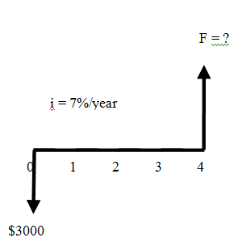
Example
$3000 deposited in a bank account at 7% per year interest would be how much after four years?
F = P(F/P, 7%, 4)
or
F = 3000(1+0.07)⁴
F = $3932.39
Dr C.J. Willis, CAPM, P.Eng
‹#›
Notes:
Equivalence is an essential factor in engineering economics
Value refers to what can be acquired with the money. Value is the worth of something
‹#›

Slide 30
Single Payment Compound Interest Formulas
Suppose you want to find an equivalent value now for a future value?
F = P(1+i)^{n}
Rearranging:
P = F/(1+i)^{n} = F(1+i)^{-n}
The notation becomes:
P = F(P/F, i, n)
Single payment present worth factor
Dr C.J. Willis, CAPM, P.Eng
‹#›
Notes:
We use equivalence when comparing projects with cash flows over ‘n’ time periods
‹#›

Slide 31
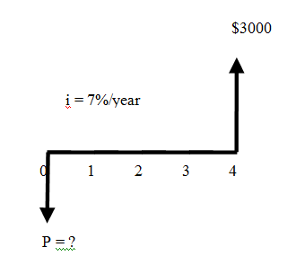
Example
If you want to have $3000 in the bank after four years at 7% per year interest, what would you have to deposit now?
P = F(P/F, 7%, 4)
or
P = 3000(1+0.07)⁻⁴
P = $2288.69
Dr C.J. Willis, CAPM, P.Eng
‹#›
Notes:
Interest formulas are used to facilitate equivalence computations
‹#›

Slide 32
Summary
The ‘time value of money’ is an important concept in engineering economics.
To calculate equivalency across multiple periods one must include the calculation of a percentage rate per period (e.g., interest rate).
F = P(1+i)^{n} = P(F/P, i, n)
P = F/(1+i)^{n} = F(1+i)^{-n} = F(P/F, i, n)
The notation factors can be calculated from the formula or looked up in standard tables. See the back of the textbook.
Dr C.J. Willis, CAPM, P.Eng
‹#›

Slide 33
Engineering Management Principles and Economics ENGR 301
Lecture 5B
Types of Cash Flows
Dr C.J. Willis, CAPM, P.Eng
‹#›

Slide 34
Single Cash Flow
F = P (1+i)^{n} = P (F/P,i,N)
Compound amount factor
The process of finding F is called the compounding process
The process of finding P is called the discounting process
Dr C.J. Willis, CAPM, P.Eng
‹#›

Slide 35
Single Cash Flow
Example: Compound amount factor
Find F, given i, n, P
If you had $2000 and invested it at 10%, how much would it be worth in 8 years?
P=$2000 i=10% n=8years
F=$2000 (1+0.10)⁸
F=$2000 (F/P,10%,8)
F=$2000 (2.144) F = $4288
1
2
3
4
5
6
7
8
$2000
Dr C.J. Willis, CAPM, P.Eng
‹#›
Notes:
(F/P,i,n) is the single payment compound amount factor
‹#›

Slide 36
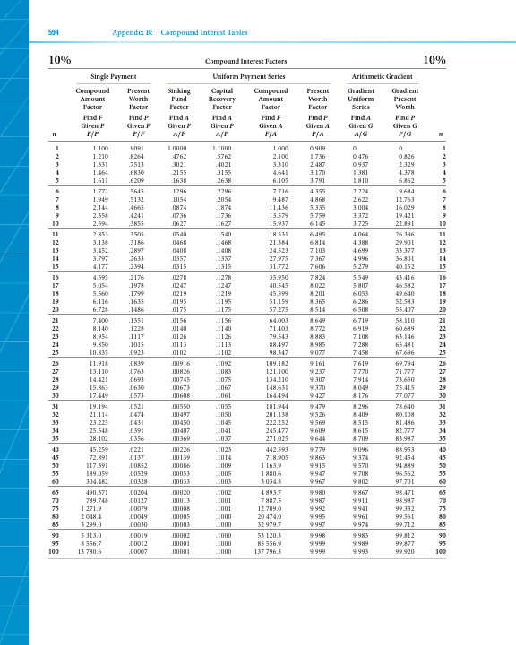
Dr C.J. Willis, CAPM, P.Eng
‹#›
Notes:
We apply the single payment compound amount formula
‹#›

Slide 37
Uneven Cash Flow Series
Example: Present Value
Wilson Technology, a growing machine shop, wishes to set aside money now to invest over the next 4 years in automating its customer service department. The company can earn 10% on a lump sum deposited now, and it wishes to withdraw the money in the following increments:
Year1: $25,000 to purchase computer and software
Year 2: $3000 for additional hardware
Year 3: $0
Year 4: $5,000 to purchase software upgrade
Dr C.J. Willis, CAPM, P.Eng
‹#›
Notes:
(P/F,i,n) find P, given F, at i, over n.
(P/F,i,n) is called the single payment present worth factor
The future value F is adjusted by the present worth factor (P/F,i,n)
‹#›

Slide 38
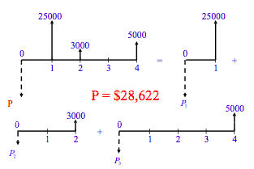
P = 25000(P/F,10%,1) + 3000(P/F,10%,2) + 5000(P/F,10%,4)
= 25000(0.9091) + 3000(0.8264) + 5000(0.6830)
= $28,622
Dr C.J. Willis, CAPM, P.Eng
‹#›
Notes:
We apply the single payment present worth formula
‹#›

Slide 39
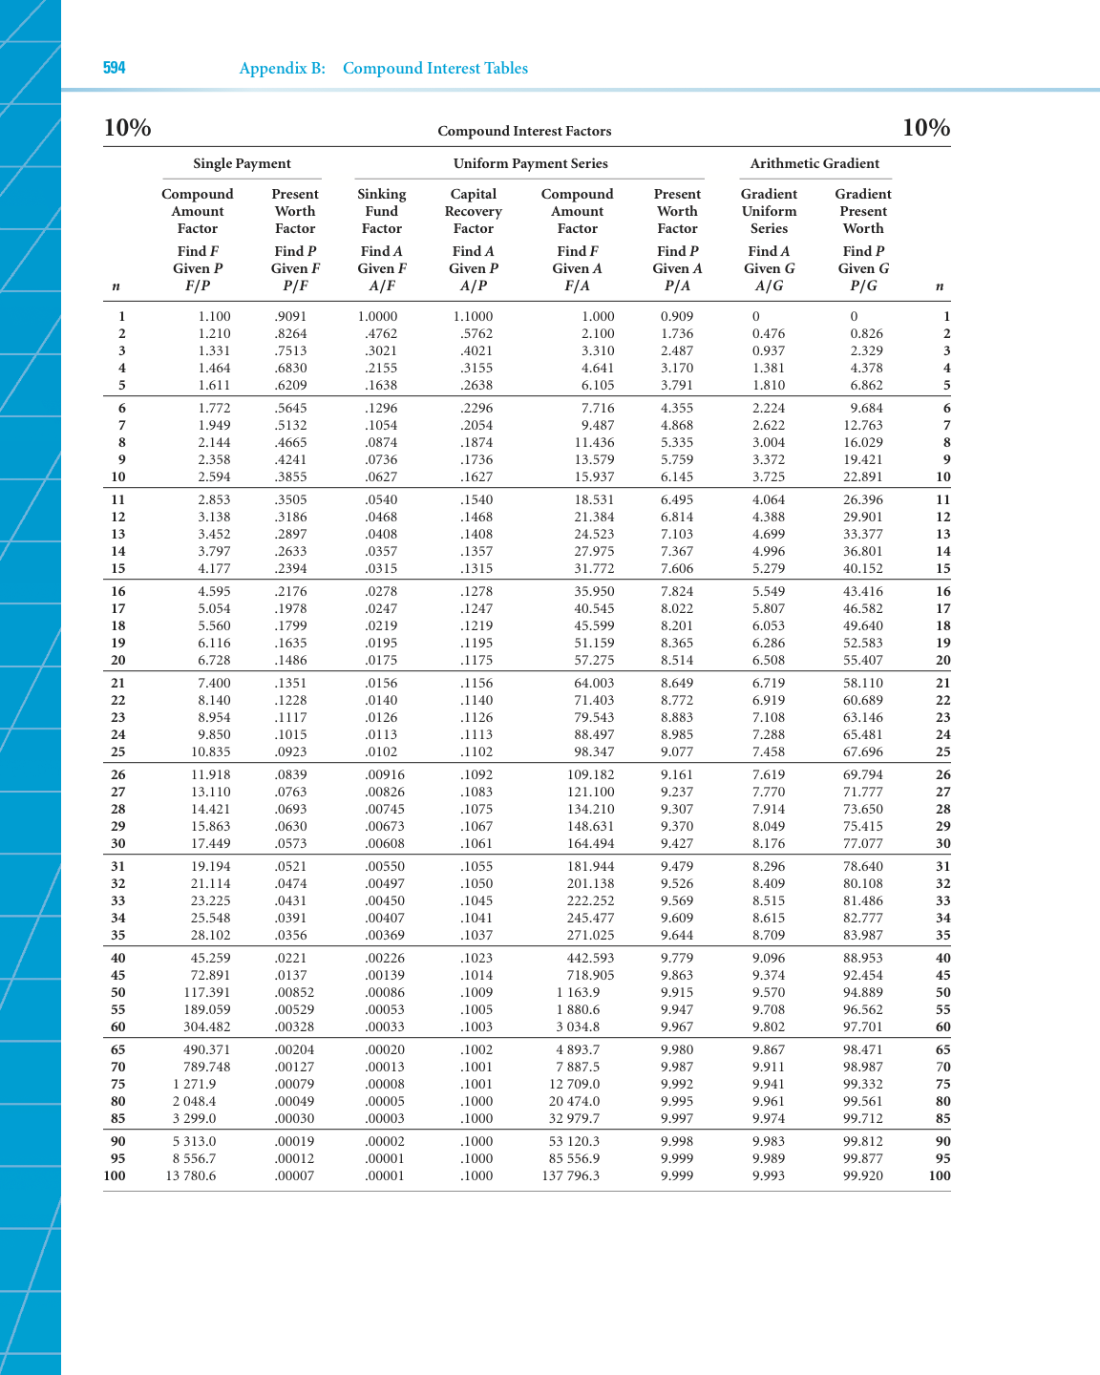
Dr C.J. Willis, CAPM, P.Eng
‹#›

Slide 40
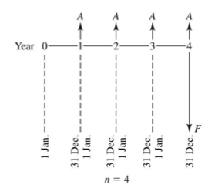
Uniform Series
Uniform series (A) is defined as:
An end-of-period cash receipt or disbursement in a uniform series, continuing for n periods, the entire series equivalent to P or F at an interest rate i
Dr C.J. Willis, CAPM, P.Eng
‹#›
Notes:
Interest rate is the cost of borrowing money.
‹#›

Slide 41
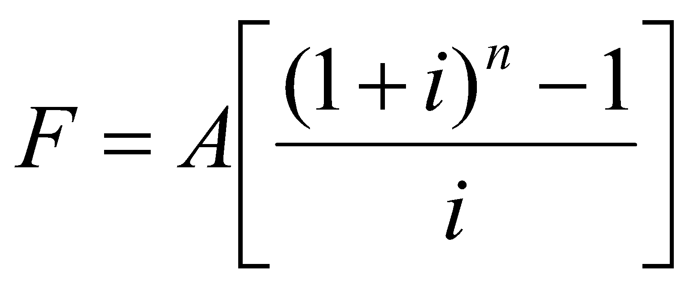
Uniform Series
F = A(1+i)^{n-1}+…+A(1+i)² +A(1+i) +A
The ‘uniform series compound amount factor’ is:
The notation is: F = A(F/A, i%, n)
Dr C.J. Willis, CAPM, P.Eng
‹#›

Slide 42
Uniform Series
Example: Compound amount factor
Suppose you make an annual contribution of $3000 to your saving account at the end of each year for 10 years. If your saving account earns 7% interest annually, how much can be withdrawn at the end of 10 years?
Dr C.J. Willis, CAPM, P.Eng
‹#›
Notes:
Example of an end of period cash disbursement would be the monthly payment of a loan
‹#›

Slide 43
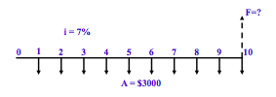
Uniform Series
F = $3000 (F/A, 7%, 10)
= $3000 (13.816) F = $41,449.34
Dr C.J. Willis, CAPM, P.Eng
‹#›

Slide 44
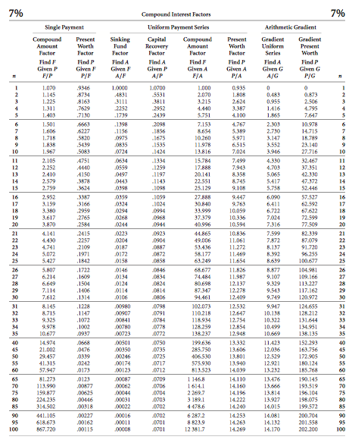
Dr C.J. Willis, CAPM, P.Eng
‹#›

Slide 45
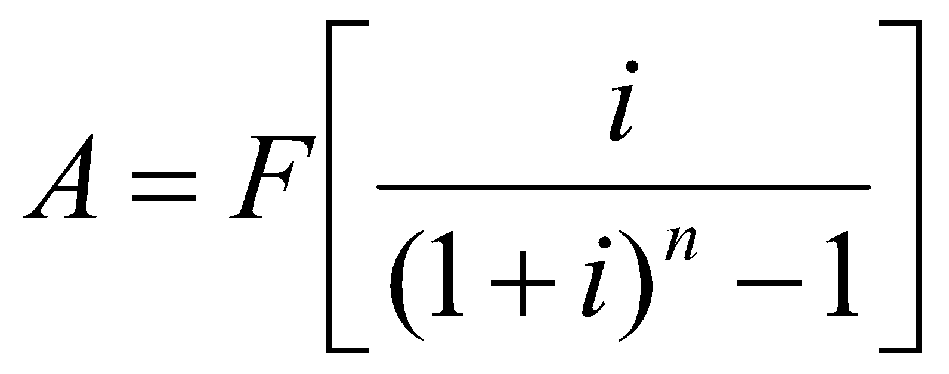
Uniform Series (Sinking Fund Factor)
A = F(A/F, i%, n)
Dr C.J. Willis, CAPM, P.Eng
‹#›

Slide 46
Uniform Series – Sinking Fund Factor
Example: (Find A, given F,i,n)
To help you reach a $5000 goal every 5 years from now, your father offers to give you $500 now. You plan to get a part time job and make 5 additional deposits at the end of each year (first deposit at the end of the first year). If all your money is deposited in a bank at 7% interest, how large must your annual deposit be?
Dr C.J. Willis, CAPM, P.Eng
‹#›
Notes:
The simple scenario is a single cash flow
You have a present sum of money and you wish to find an equivalent future sum of money.
‹#›

Slide 47
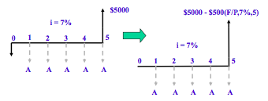
A = [$5000 - $500(F/P,7%,5)](A/F,7%,5)
= [$5000 - $500(1.4026)](0.1739)
A = $747.55
Dr C.J. Willis, CAPM, P.Eng
‹#›
Notes:
Here we are finding a future sum of money (at 8yrs) that is equivalent to our present sum of $2000 at 10% interest
We adjust the present sum by a compound amount factor.
(F/P,i,n) is called the compound amount factor.
Its value can be derived from the formula or from “compound interest tables”
‹#›

Slide 48
Dr C.J. Willis, CAPM, P.Eng
‹#›
Notes:
This is the compound interest table for i=10%.
‹#›

Slide 49
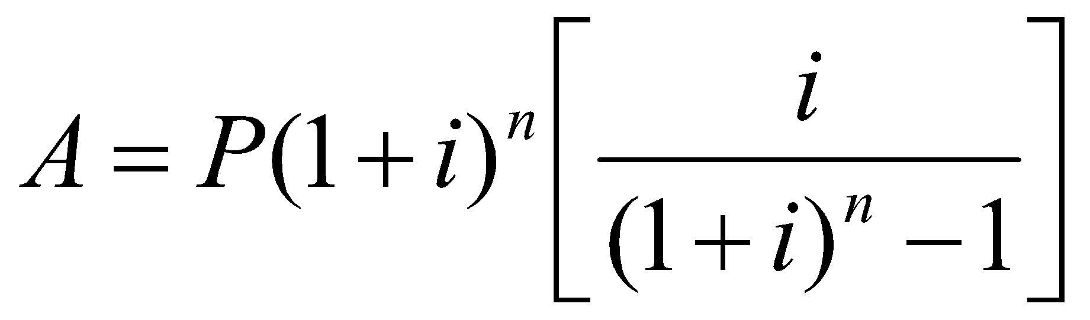
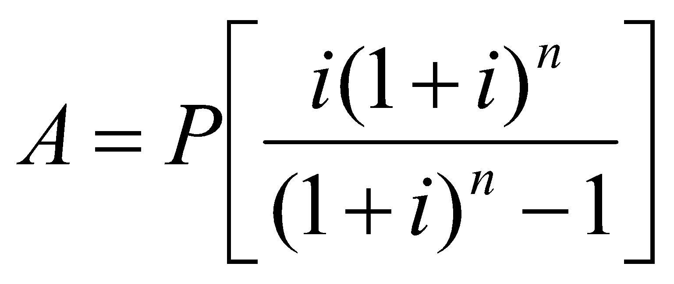
Uniform Series – Capital Recovery Factor
Taking the sinking fund formula and substituting the single payment compound formula for F yields:
Therefore:
Notation: A = P(A/P, i%, n)
‘uniform series capital recovery factor’
Dr C.J. Willis, CAPM, P.Eng
‹#›
Notes:
In this problem we would like to determine how much money to set aside now.
Instead of having a single cash flow at a point in time, it is possible to have multiple uneven cash flows at different periods of time.
How do we treat such as case?
Here, we know the future amounts and that the company wants to withdraw and their timing. We need to determine and equivalent present amount that the company needs to deposit
‹#›

Slide 50
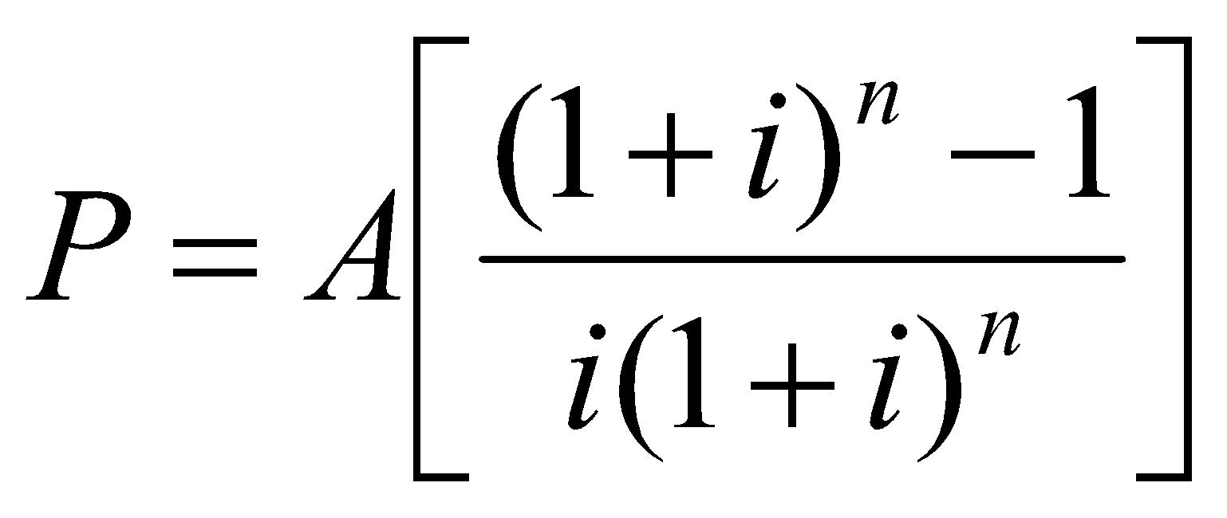
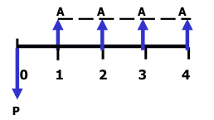
Uniform Series – Present Worth Factor
Solving the capital recovery formula for P:
Notation: P = A(P/A, i%, n)
‘uniform series present worth factor’
Dr C.J. Willis, CAPM, P.Eng
‹#›
Notes:
We deal with each cash flow individually and then add them up.
We know the amount the company wants to withdraw in the future and the timing of these withdrawals. We need to find the Present Amount the company needs to deposit now that is equivalent to the total of the future withdrawals.
For each withdrawal we can determine a present amount, then add up the present amounts.
We adjust the future amounts by the present worth factor
‹#›

Slide 51
Uniform Series
Example: Find A, given P, i, n
A small biotechnology firm has borrowed $250,000 to purchase laboratory equipment for gene splicing. The loan carries an interest rate of 8% per year and is to be repaid in equal installments over the next 6 years. Compute the amount of this annual installment.
Dr C.J. Willis, CAPM, P.Eng
‹#›

Slide 52
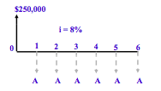
A = $250,000 (A/P,8%,6)
= $250,000 (0.2163)
A=$54,075
Dr C.J. Willis, CAPM, P.Eng
‹#›
Notes:
This is a table of the compound interest factors at i=10%
‹#›

Slide 53
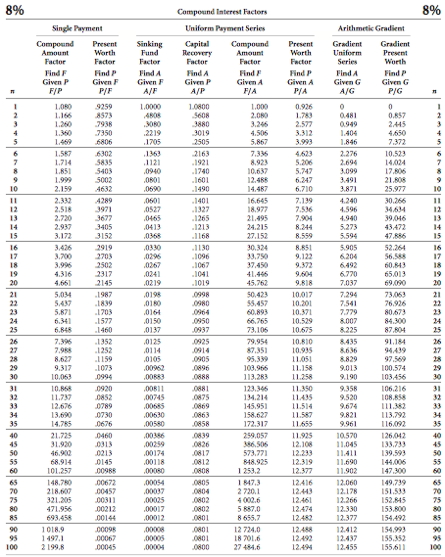
Dr C.J. Willis, CAPM, P.Eng
‹#›

Slide 54
Uniform Series
Example: Deferred loan repayment
Suppose that in the last example the bank agreed to defer the first loan repayment until the end of year 2.
Dr C.J. Willis, CAPM, P.Eng
‹#›

Slide 55
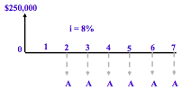
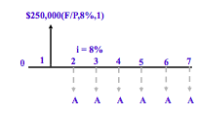
A = [$250,000 (F/P,8%,1)]*(A/P,8%,6)
= [$250,000 (1.08)]*(0.2163)
= $58,401
Dr C.J. Willis, CAPM, P.Eng
‹#›
Notes:
Examples of uniform series include payment of automobile loans and house payments.
It is customary to define A as an end of period event rather than a beginning of period or mid period event
‹#›

Slide 56
Uniform Series
Example: Find P, given A,i, n
John is a factory worker who won the lottery and will receive his winning ticket in 21 annual payments of about $24,000. He decided to quit the factory and start his own business, which required him to secure a $250,000 bank loan. John offered to put up his future lottery earnings to secure the loan. If the bank’s interest rate is 10% per year, how much can john borrow against his future lottery earning?
Dr C.J. Willis, CAPM, P.Eng
‹#›

Slide 57

P = $24,000 (P/A,10%,21) = $24,000 (8.649)
P = $207,569 < $250,000
Dr C.J. Willis, CAPM, P.Eng
‹#›
Notes:
(F/A,i,n) is referred to as a uniform series compound amount factor and is given in the compound interest tables.
Notation (F/A,i,n) means find F given A.
We want to find a future amount that is equivalent to the uniform series over time at some rate i%
‹#›

Slide 58
Arithmetic Gradient Series
Frequently, the cash flow series is not a constant amount A. Instead it is a uniformly increasing series.
A uniformly increasing series:
Consists of two components:
Series component (A)
Gradient component (G)
Therefore:
P = A(P/A, i%, n) + G(P/G, i%, n)
A+3G
A+2G
A+G
A
0 1 2 3 4
P
Arithmetic Gradient Present Worth Factor
Dr C.J. Willis, CAPM, P.Eng
‹#›
Notes:
$3000 represents are uniform series of deposits. We want to find the equivalent future value (F) of the uniform series of deposits after 10years
‹#›

Slide 59
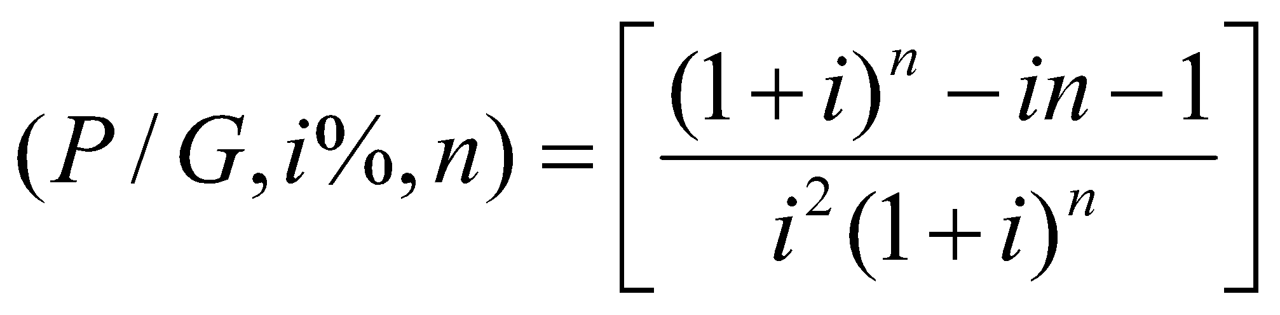
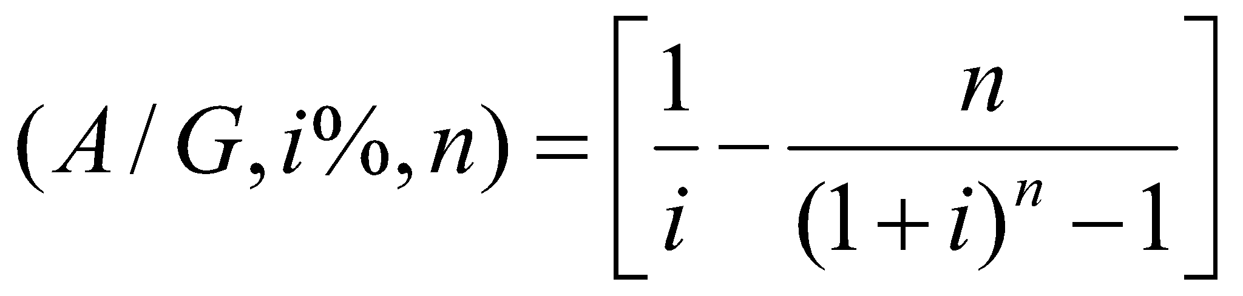
Arithmetic Gradient Factors
‘arithmetic gradient present worth factor’:
‘arithmetic gradient uniform series factor’:
Dr C.J. Willis, CAPM, P.Eng
‹#›
Notes:
To find the equivalent future value we adjust the uniform annual deposit by the “uniform payment series compound amount factor”
Factor 13.816 is derived from the compound interest tables
‹#›

Slide 60
Arithmetic Gradient Series
Example
John and Barbara have just opened two savings accounts at their credit union. The accounts earn 10% annual interest. John wants to deposit $1000 in his account at the end of the first year and increase this amount by $300 for each of the following 5 years. Barbara wants to deposit an equal amount at the end of each year for the next 6 years. What should the size of Barbara’s annual deposit be so that the two accounts would have an equal balance at the end of 6 years?
Dr C.J. Willis, CAPM, P.Eng
‹#›

Slide 61



A = $1000 + $300(A/G,10%,6)
= $1000 + $300(2.224)
= $1667.20
=
+
Dr C.J. Willis, CAPM, P.Eng
‹#›
Notes:
A sinking fund is a separate fund into which one makes a uniform series of money deposits (A) with the goal of accumulating some desired future sum (F) at a given future point in time.
The sinking fund factor allows us to determine a uniform annual amount, which overtime will be equivalent to some future sum.
‹#›

Slide 62
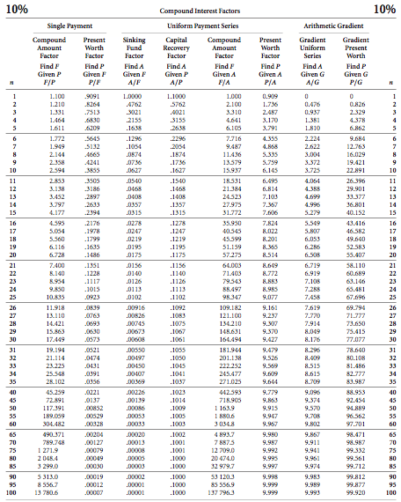
Dr C.J. Willis, CAPM, P.Eng
‹#›

Slide 63
Geometric Gradient Series
Period-by-period change is at a uniform rate (g)
Expressed as a percentage
A+(1+g)³
A(1+g)
A(1+g)²
A
0 1 2 3 4
P
Dr C.J. Willis, CAPM, P.Eng
‹#›
Notes:
We know the future amount we want to reach is $5000
N=5 years
i=7%
A?
‹#›

Slide 64
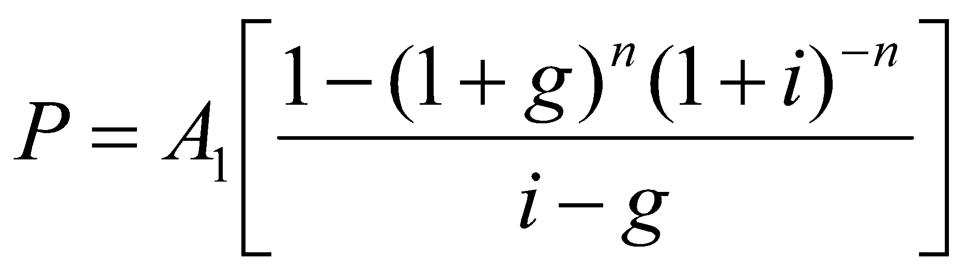

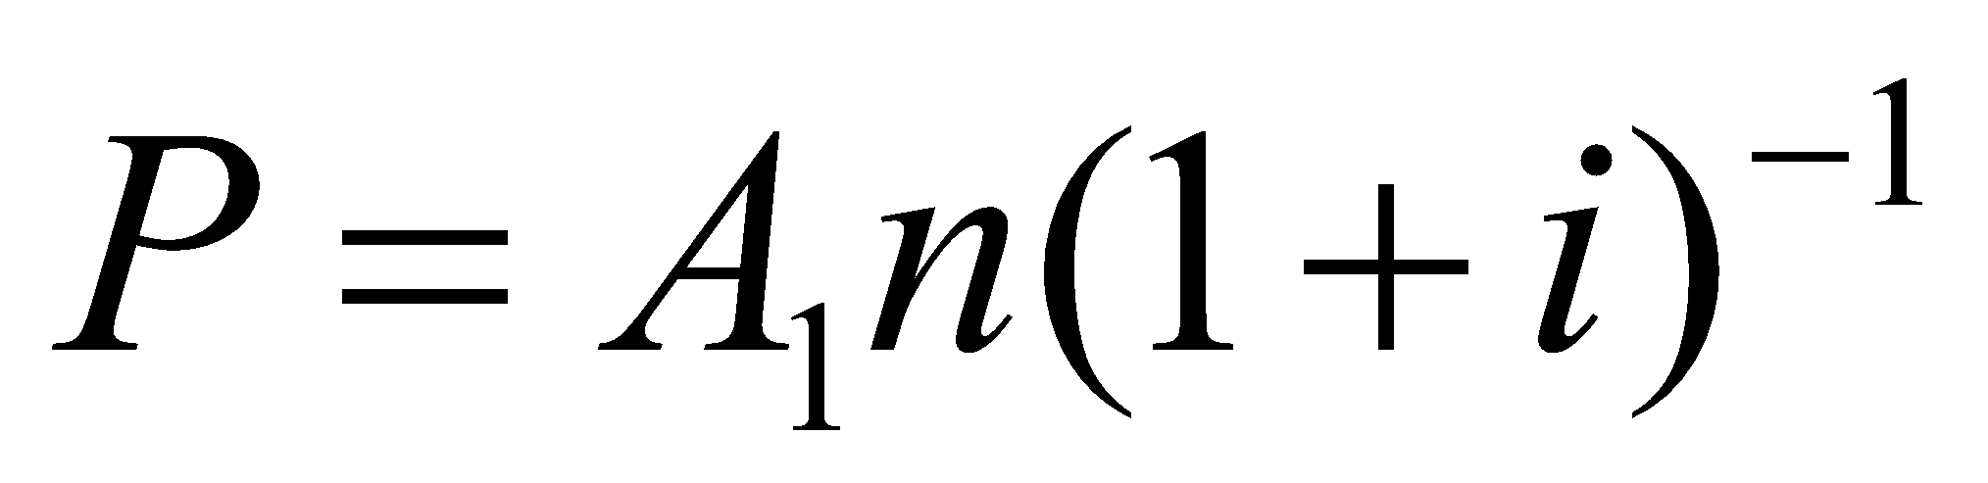
Geometric Gradient Formulas
Two possible cases:
Where: i ≠ g
Where: i = g
Factor Notation: (P/A, g, i, n)
Dr C.J. Willis, CAPM, P.Eng
‹#›
Notes:
We have a Present sum $500. We need to know how much it is equivalent to in five years.
The equivalent future value of our $500 is subtracted from our goal of $5000.
The sinking fund factor is then applied to this difference to determine the uniform annual deposit we should be making.
Considering the $500 we have at present, we should be depositing $747.55 every year to reach our goal of $5000
‹#›

